Slide 1
Age Old Battle: Fruits vs Vegetables
DATA 605 Project by Alister Salmon
February 10, 2024
Notes:
Welcome to my presentation for the final project in data 605.
I will be attempting to settle the Age Old Battle of fruits vs vegetables.
Lets get started!

Slide 2
Dataset
https://www.ers.usda.gov/data-products/fruit-and-vegetable-prices.aspx
Available through to Freedom of Information Act, 5 U.S.C. 552
Two datasets: ALL FRUITS – Avg prices, ALL Vegetables – Avg prices,
Features of each: Food, Form, RetailPrice, RetailPriceUnit, Yield, CupEquivalentSize, CupEquivalentUnit, CupEquivalentPrice
Size: 62 fruits, 93 vegetables
No cleaning needed!
Notes:
First, we need data. The dataset I used was from data.gov and was available through the Freedom of Information Act.
The dataset consists of two tables, a fruits and a vegetables table.
Both of these tables are identical in structure. The feature labels are Food, Form, RetailPrice, RetailPriceUnit, Yield, CupEquivalentSize, CupEquivalentUnit, CupEquivalentPrice.
As I’ve got 62 fruits and 93 vegetables to settle this battle. Right off the bat, vegetables has the numbers to beat fruits. But maybe fruits has the strategy.
Thankfully, I didn’t have to do any cleaning other than combining the datasets.

Slide 3
Objectives
Explore the distributions of yield and prices of fruits and vegetables
Compare the yield and price per cup of different forms of fruits and different forms of vegetables
Use unsupervised and supervised learning to predict fruit or vegetable based on retail price, yield, and price per cup
Tool used: R, R, and maybe ggplot2
Notes:
The main objectives I used to guide my investigation were:
Explore the distributions of yield and price of fruits and vegetables
Compare the yield and price per cup of different forms of fruits and different forms of vegetables (that’s two objectives)
And use unsupervised and supervised learning to predict fruit of vegetable.
Although using machine learning won’t settle if fruits are better than vegetables, we can use it to see if there is any different between them.

Slide 4
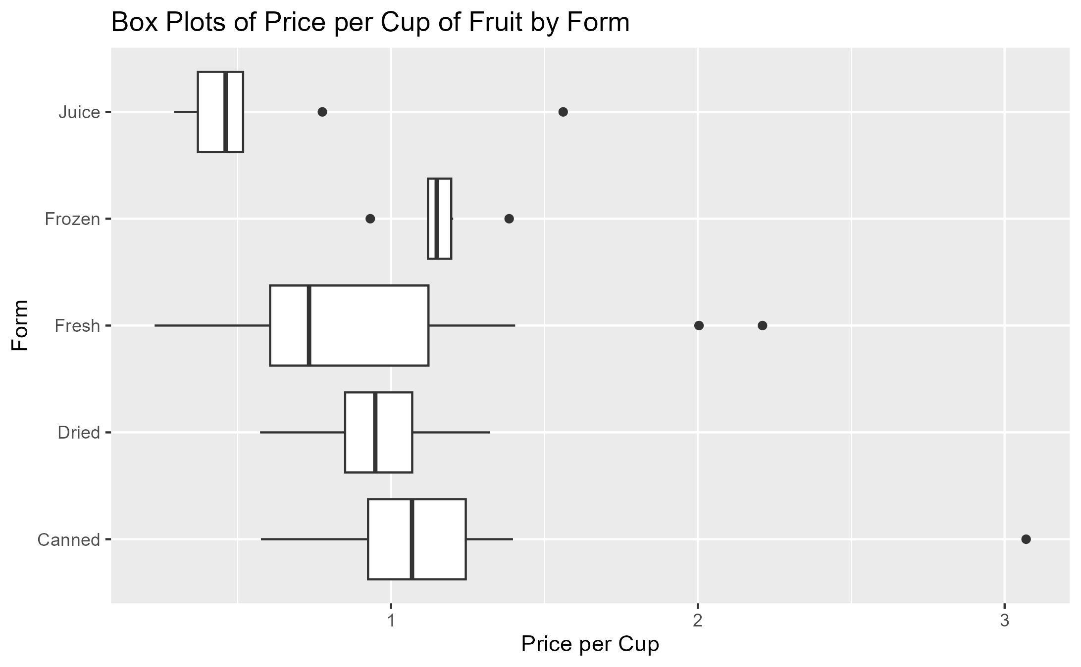
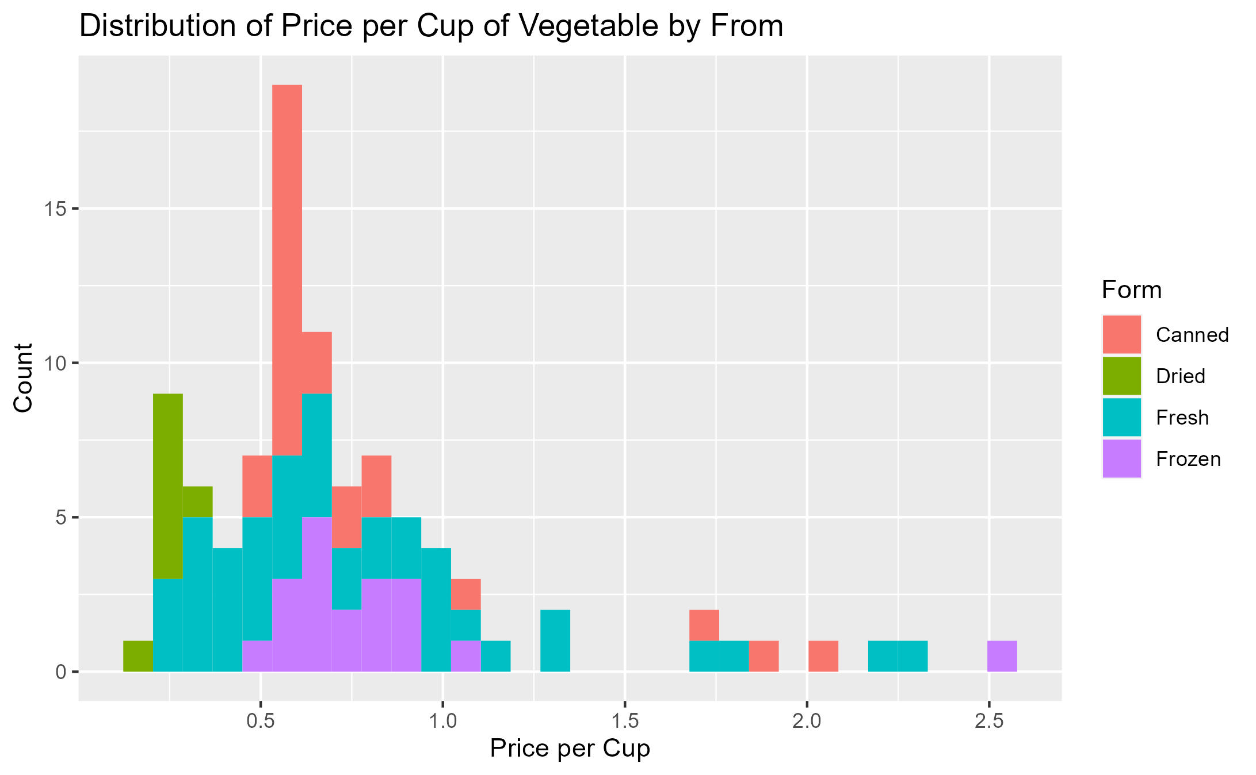
Spilt Milk
Fruits
Vegetables
Notes:
As the saying goes: there is no use crying over spilt milk
Or in this case, the distributions of fruits and vegetables.
Almost all fruits had a yield of 1 so I decided to not show that plot. However, the price was best represented with box plots.
My main takeaways from the box plots are that fresh fruits have a large variance and juice and frozen fruit are quite homogenous.
As for vegetables, canned fresh and frozen look to have their means quite close and dried is much lower.
If you are curious for more information, feel free to read my post on Medium or look at all the visuals I produced. I’ll have a link in my Medium post.

Slide 5
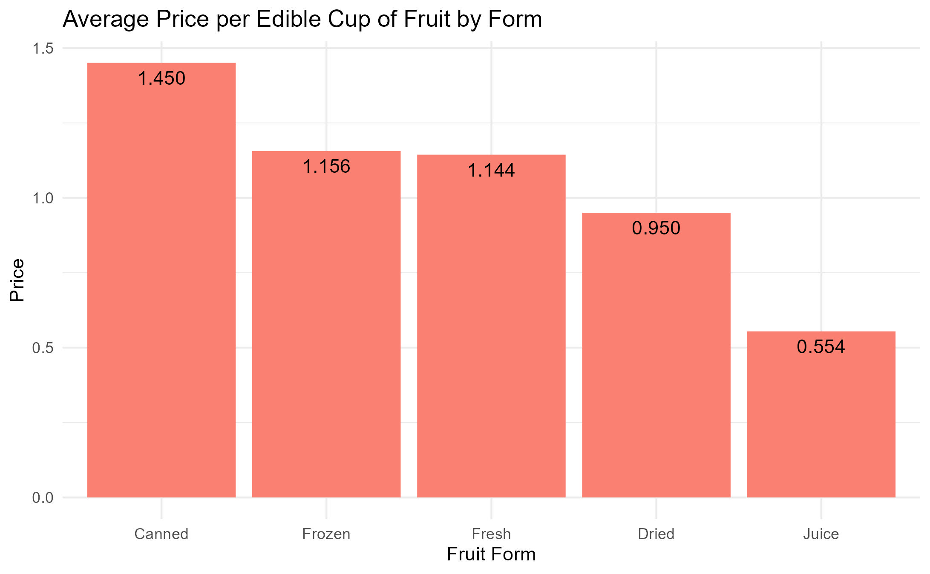
Apples to Oranges
Notes:
I first compared the average price and average yield based on form separately.
But I figured better insights could be drawn from combining them to compare the average price per edible cup.
The reason juice is so much lower is because of the frozen juice concentrate which is considered juice instead of frozen (atleast for this dataset)
And we all know that stuff is cheap.
Interestingly, I didn’t expect canned vegetables to be this much more expensive.
However, this could be, and most likely is, a misleading visualization because this dataset did not have the calorie density of the foods.

Slide 6
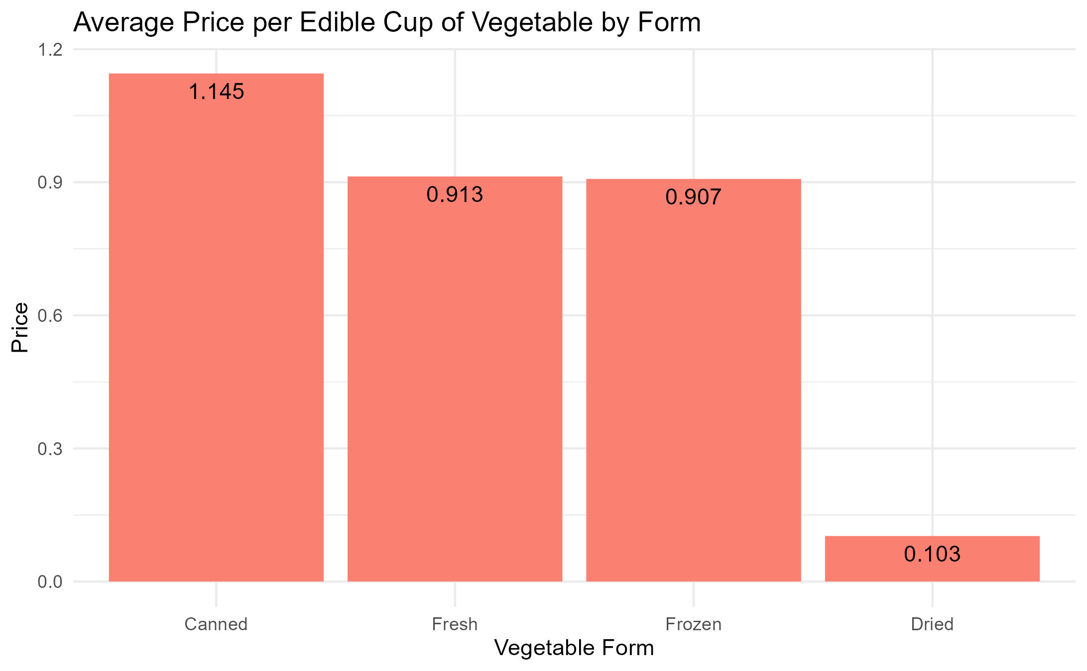
Carrots to Cabbages
Notes:
Instead of apples to oranges, lets compare carrots to cabbages.
Or, in more understandable terms, the different forms of vegetables based on their average price per edible cup.
Unsurprisingly, dried vegetables are the lowest, This is due to dried beans which are cheap and expand when cooked (unless you eat them right out of the bag, if you do eat them like that, please come find me. I am curious)

Slide 7
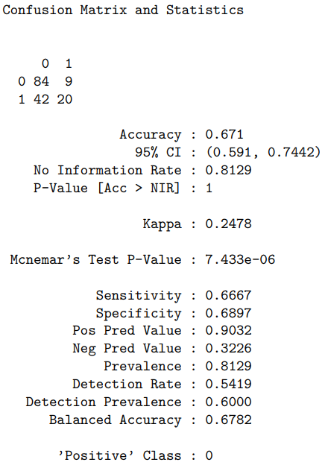
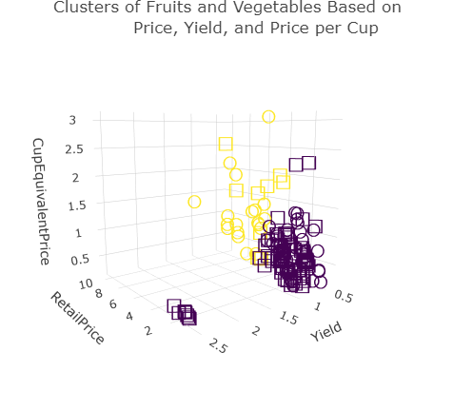
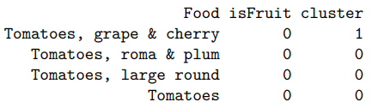
Is Tomato A Fruit?
Notes:
Can unsupervised learning tell us if a tomato is a fruit? The short answer: no.
The long answer: I used K-Means clustering to cluster all the fruits and vegetables based on retail price, yield, and cup equivalent price.
And then labeled the clusters to their majority (whether it was fruits or vegetables).
The model had an accuracy of 67% and, based on the p-value of 1, this is no better than randomly guessing if a product is a fruit or vegetable.
However, using this model without taking the uselessness into account,
Larger tomatoes are vegetables and cherry tomatoes are fruits.

Slide 8
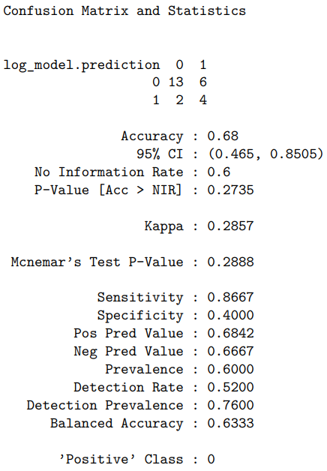
The Regression of Fruits and Vegetables
Notes:
Maybe supervised will perform better!
Well it did. But still not good enough.
It had a similar accuracy but better p-value.
However, since the p-value is greater than 0.05, I couldn’t conclude that this model was any good.

Slide 9
Conclusion
Vegetables are cheaper than fruit
Cheapest form of fruit: juice
Cheapest form of vegetable: dried
K-Means says cherry tomatoes are fruits
Give me the yield, price, and price per cup of a product and I wouldn’t be able to tell you if it was a fruit or vegetable
Notes:
Some quick conclusions and key takeaways I got:
Vegetables tend to be cheaper than fruit.
The cheapest form of fruit is juice
The cheapest form of vegetable is dried (although, I already suspected this)
Cherry and grape tomatoes are fruits. Which makes sense because it is in the name
Please note the sarcasm in my voice there
And, if you were to give me the yield, retail price, and price per cup of a product, I wouldn’t be able to tell you if it a fruit or a vegetable. You might as well give it to a monkey and see if they eat it.
Thank you for listening. Remember, if you want to see my code or more visualizations, head to my Medium post.

